Slide 1
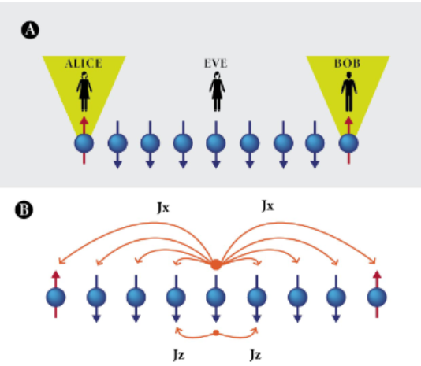
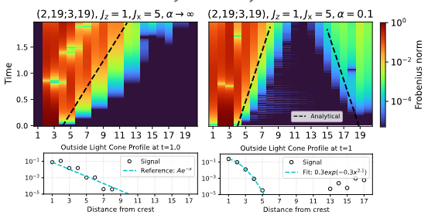
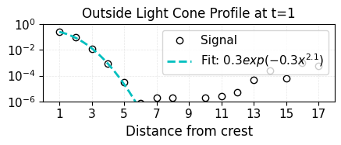
Fixed x axis
SR
Increase fontsize of, should see the other cone, increase size
Remove plot titles, instead SR and LR, even outsie the light cone profile
Keep fit
1e-6 for OLC profile, larger plot dimension

Slide 2
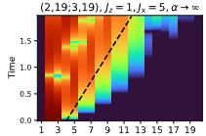
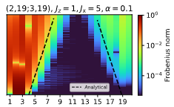
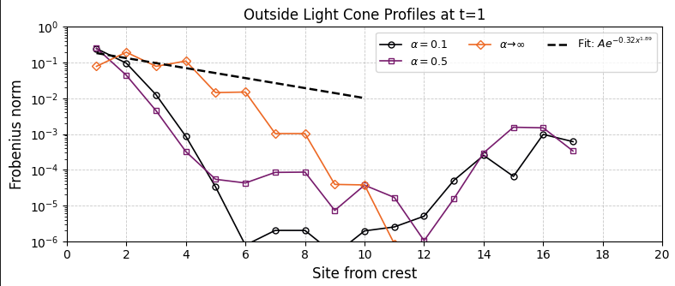
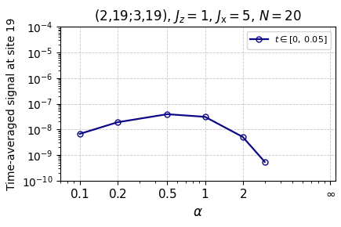
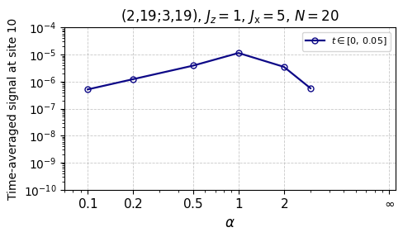
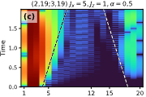
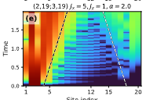
Fixed x axis
SR
superimpose
Increase fontsize of, should see the other cone, increase size
Remove plot titles, instead SR and LR, even outsie the light cone profile
Keep fit
1e-6 for OLC profile, larger plot dimension, same size for all of them

Slide 3
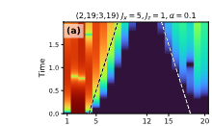

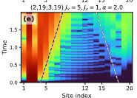
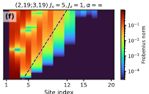

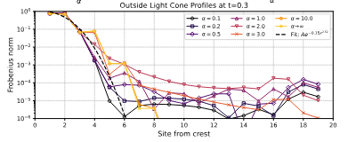
Fixed x axis

Slide 4
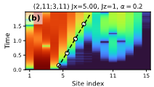
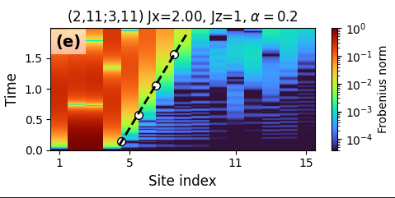
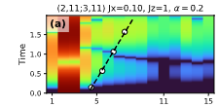
Fig 2
Add scaling with N and Jx with closed boundary conditions

Slide 5
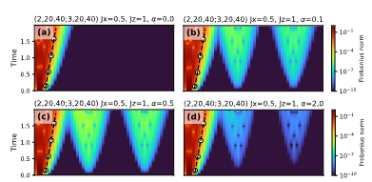
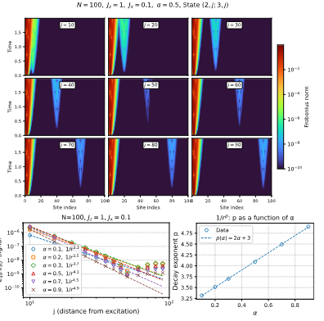


Fig 4
Change time for no overlap (t=1)
(2,20, j;3,20,j)
J=30, 40, 50, 60
Profile as a function of j
Something like this with 3 cones

